Slide 1

2025 Computer Science LC Project
Exam No: 230620

Slide 2
Basic Requirements of the assessment
Collect and Prepare the Data
Data analytics and visualisation
Basic interactive information system interface

Slide 3
Collect and Prepare the Data
My dataset:
Steam Games Dataset by Martin Bustos
A dataset including 97000+ games on Steam
Data cleaning:
Application: Thonny
Language: Python
Add-ins: Pandas, Firebase admin

Slide 4
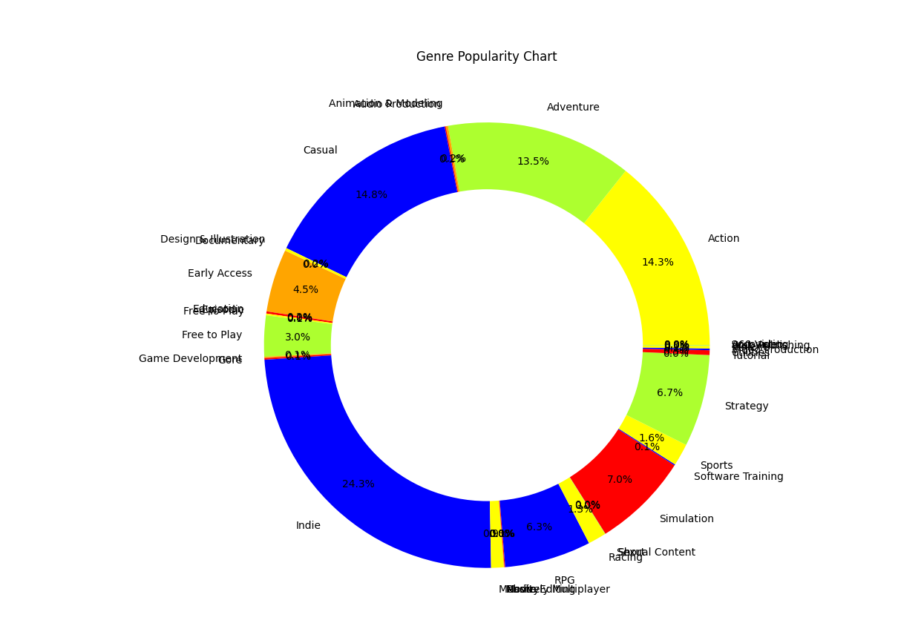
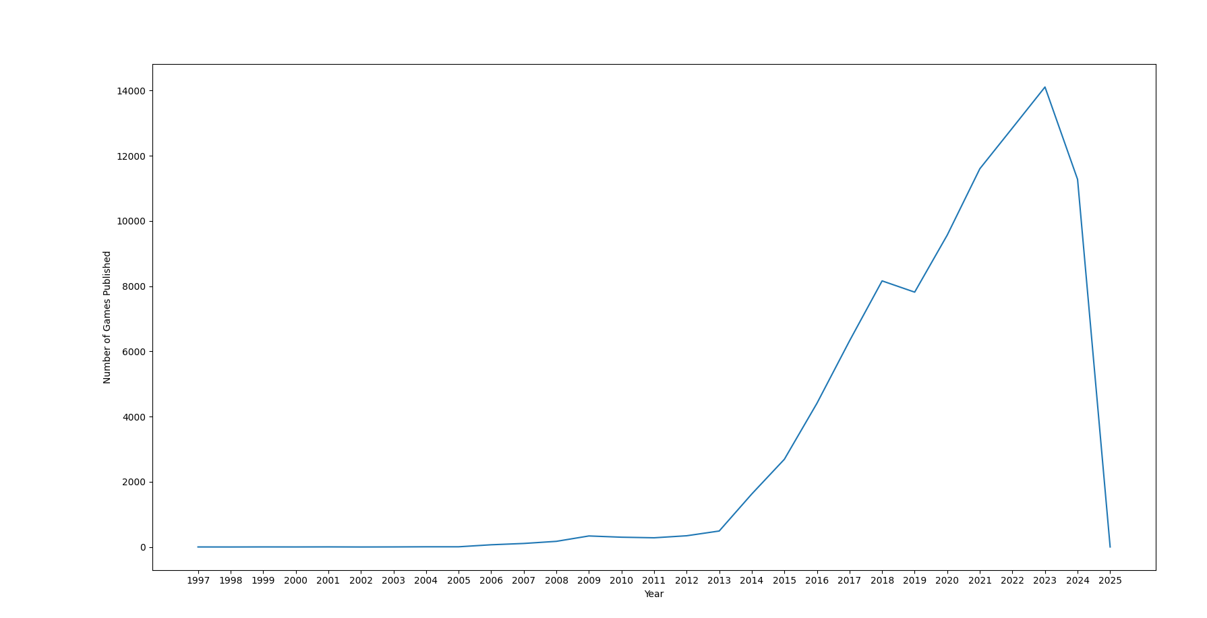
Data analytics and visualisation
Application: Thonny
Language: Python
Add-ins: Matplotlib, Numpy, Firebase admin
Graphs:
Plot line – [Timeline]
Doughnut/Pie –[Genre]

Slide 5
Basic interactive information system interface
Application: Visual Studio Code
Coding Language: Java Script
Web Language: HTML
Add-ins: Firebase admin

Slide 6
Advanced Requirements of the assessment
User interactability
Form or poll of chosen dataset
Recommendations based on analysis of chosen dataset

Slide 7


User interactability
Graph interactability

Slide 8
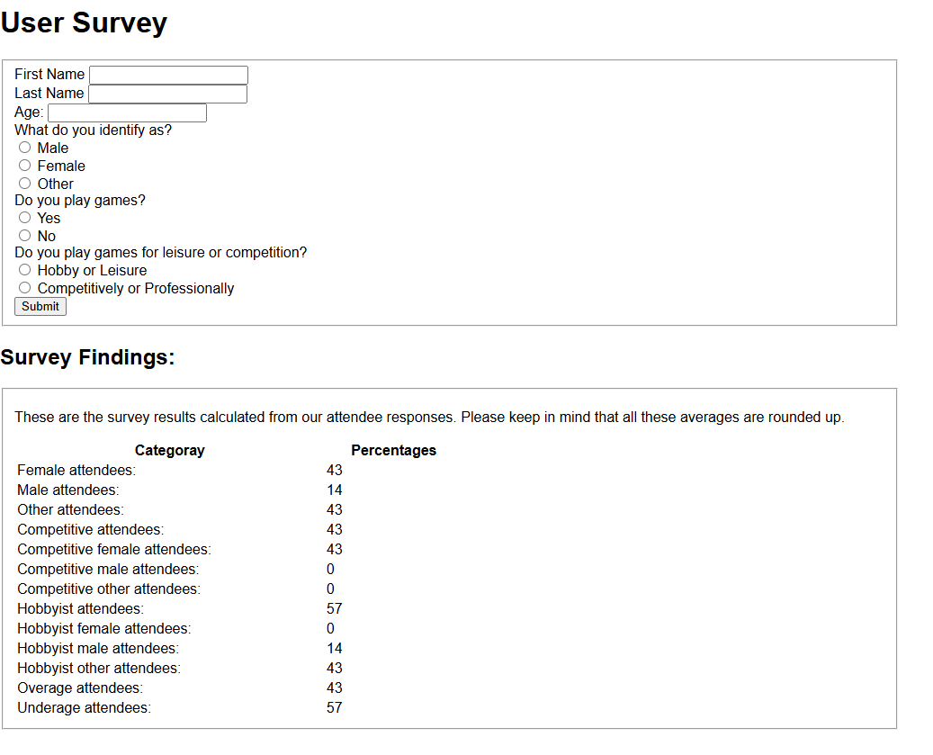
Form or poll of chosen dataset
User survey

Slide 9
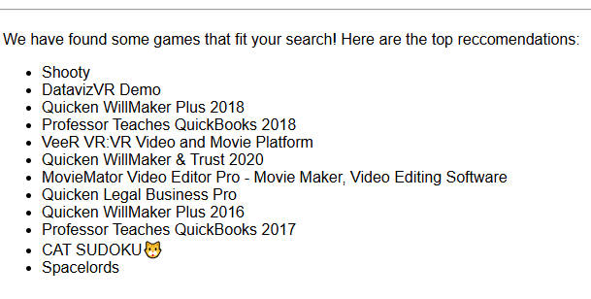
Recommendations based on analysis of chosen dataset
Game recommendation checklist

